Slide 1




Slide 2

Unit 7

Slide 3


Opener

Slide 4
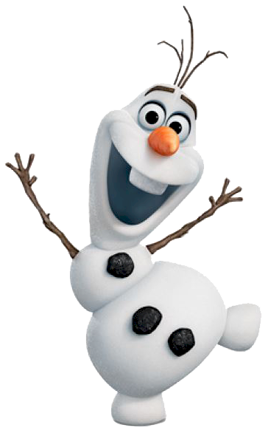
Can You Find The Six Words Hidden In These Pictures?

Slide 5
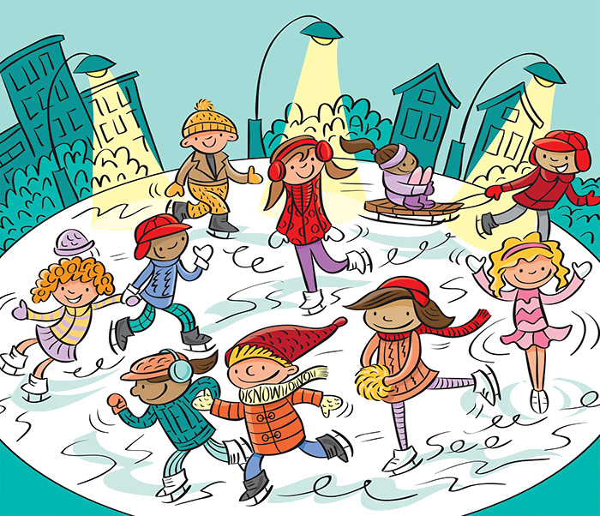

Slide 6
cut
man
tell
snow
see
cool

Slide 7



Choose the correct word to fill in spaces.

Slide 8
1. ………………. Andrew was warned of the risks, he decided to travel alone to South America.
Although
although
2. He bought the watch ………………. it was too expensive.
however
3. He passed the test,………………. he didn’t get the job.

Slide 9
4. ………………. I don’t agree with him, I think that he is honest.
Although
however
5. The weather was stormy, ………………. we want to go to the park.
although
6. I finished my homework,………………. it wasn’t easy.

Slide 10


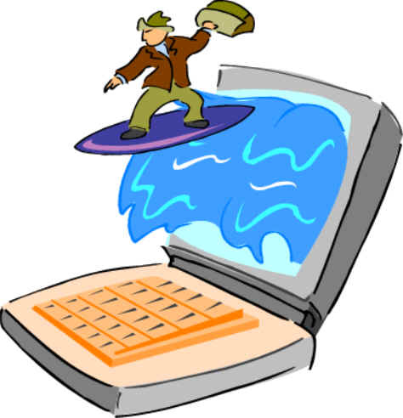

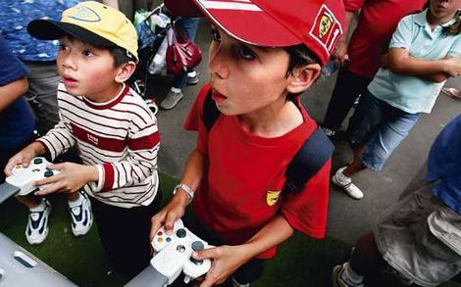
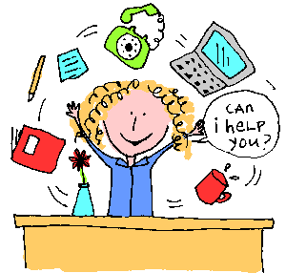
The social media can help us to
How is social media useful?
send messages
book tickets online
buy online
surf the Net
play games
do homework
read books

Slide 11
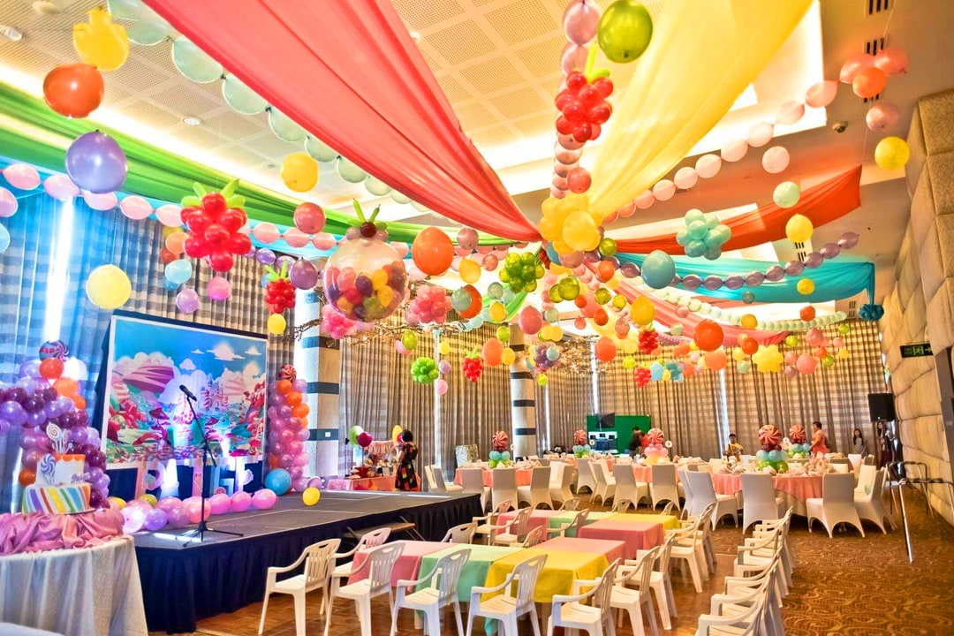
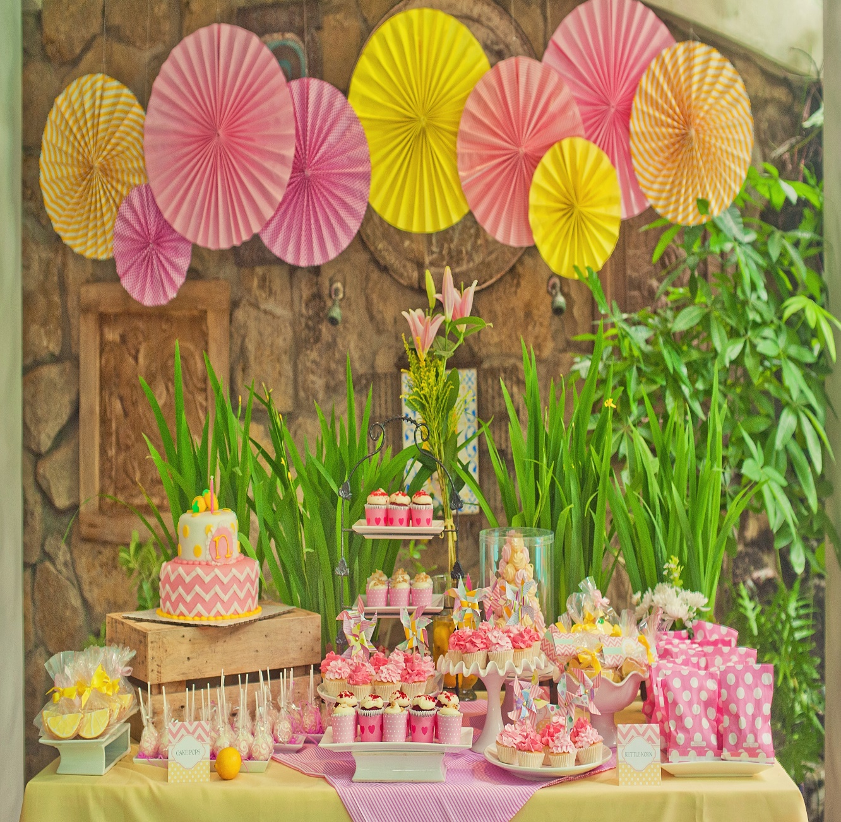
The parents had made all the arrangements for their daughter’s birthday party.

Slide 12


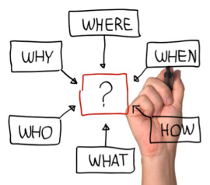

arrangement
a plan for how something will happen

Slide 13
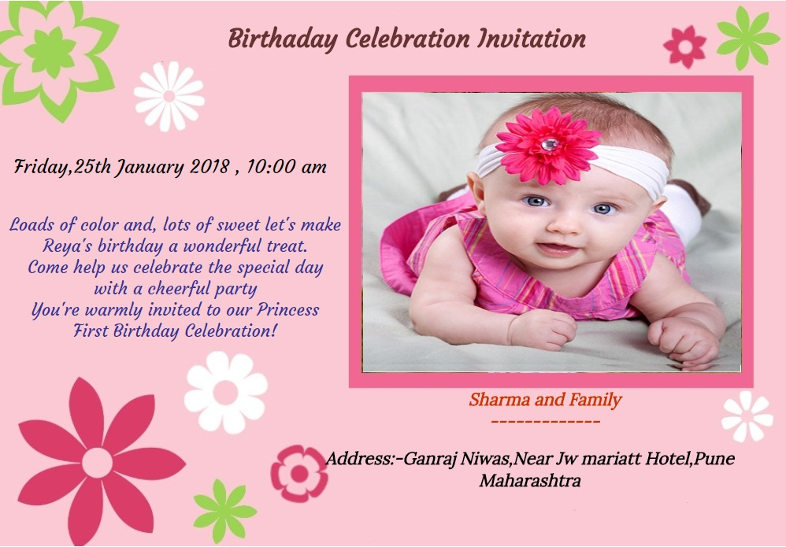
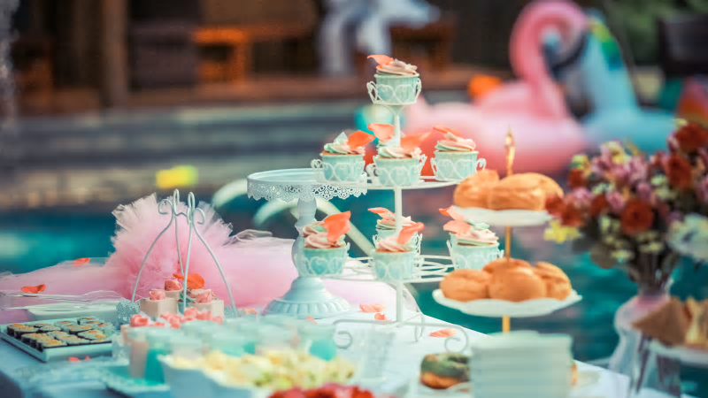


Then, they sent the birthday party invitation on WhatsApp and Snapchat.

Slide 14
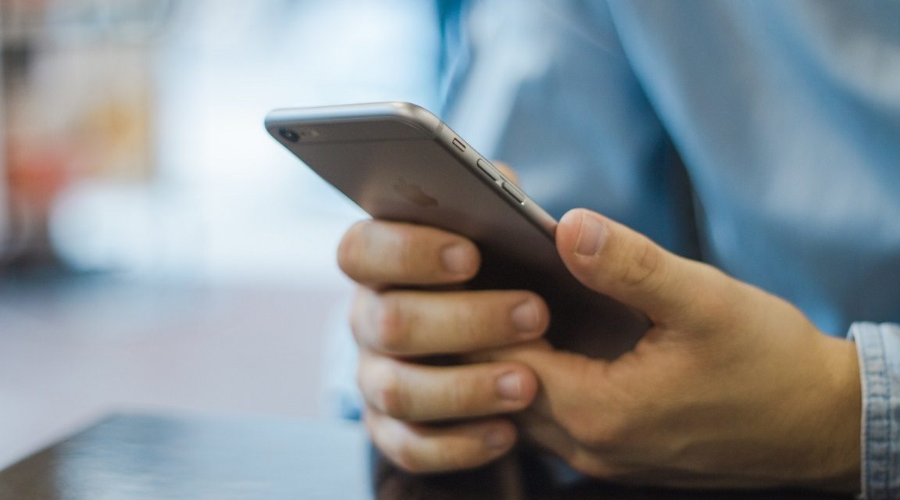
Student’s Book
Page 59

Slide 15
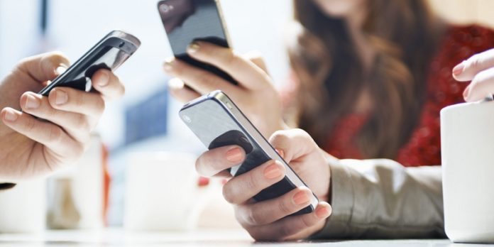
Leaving messages

Slide 16



Slide 17
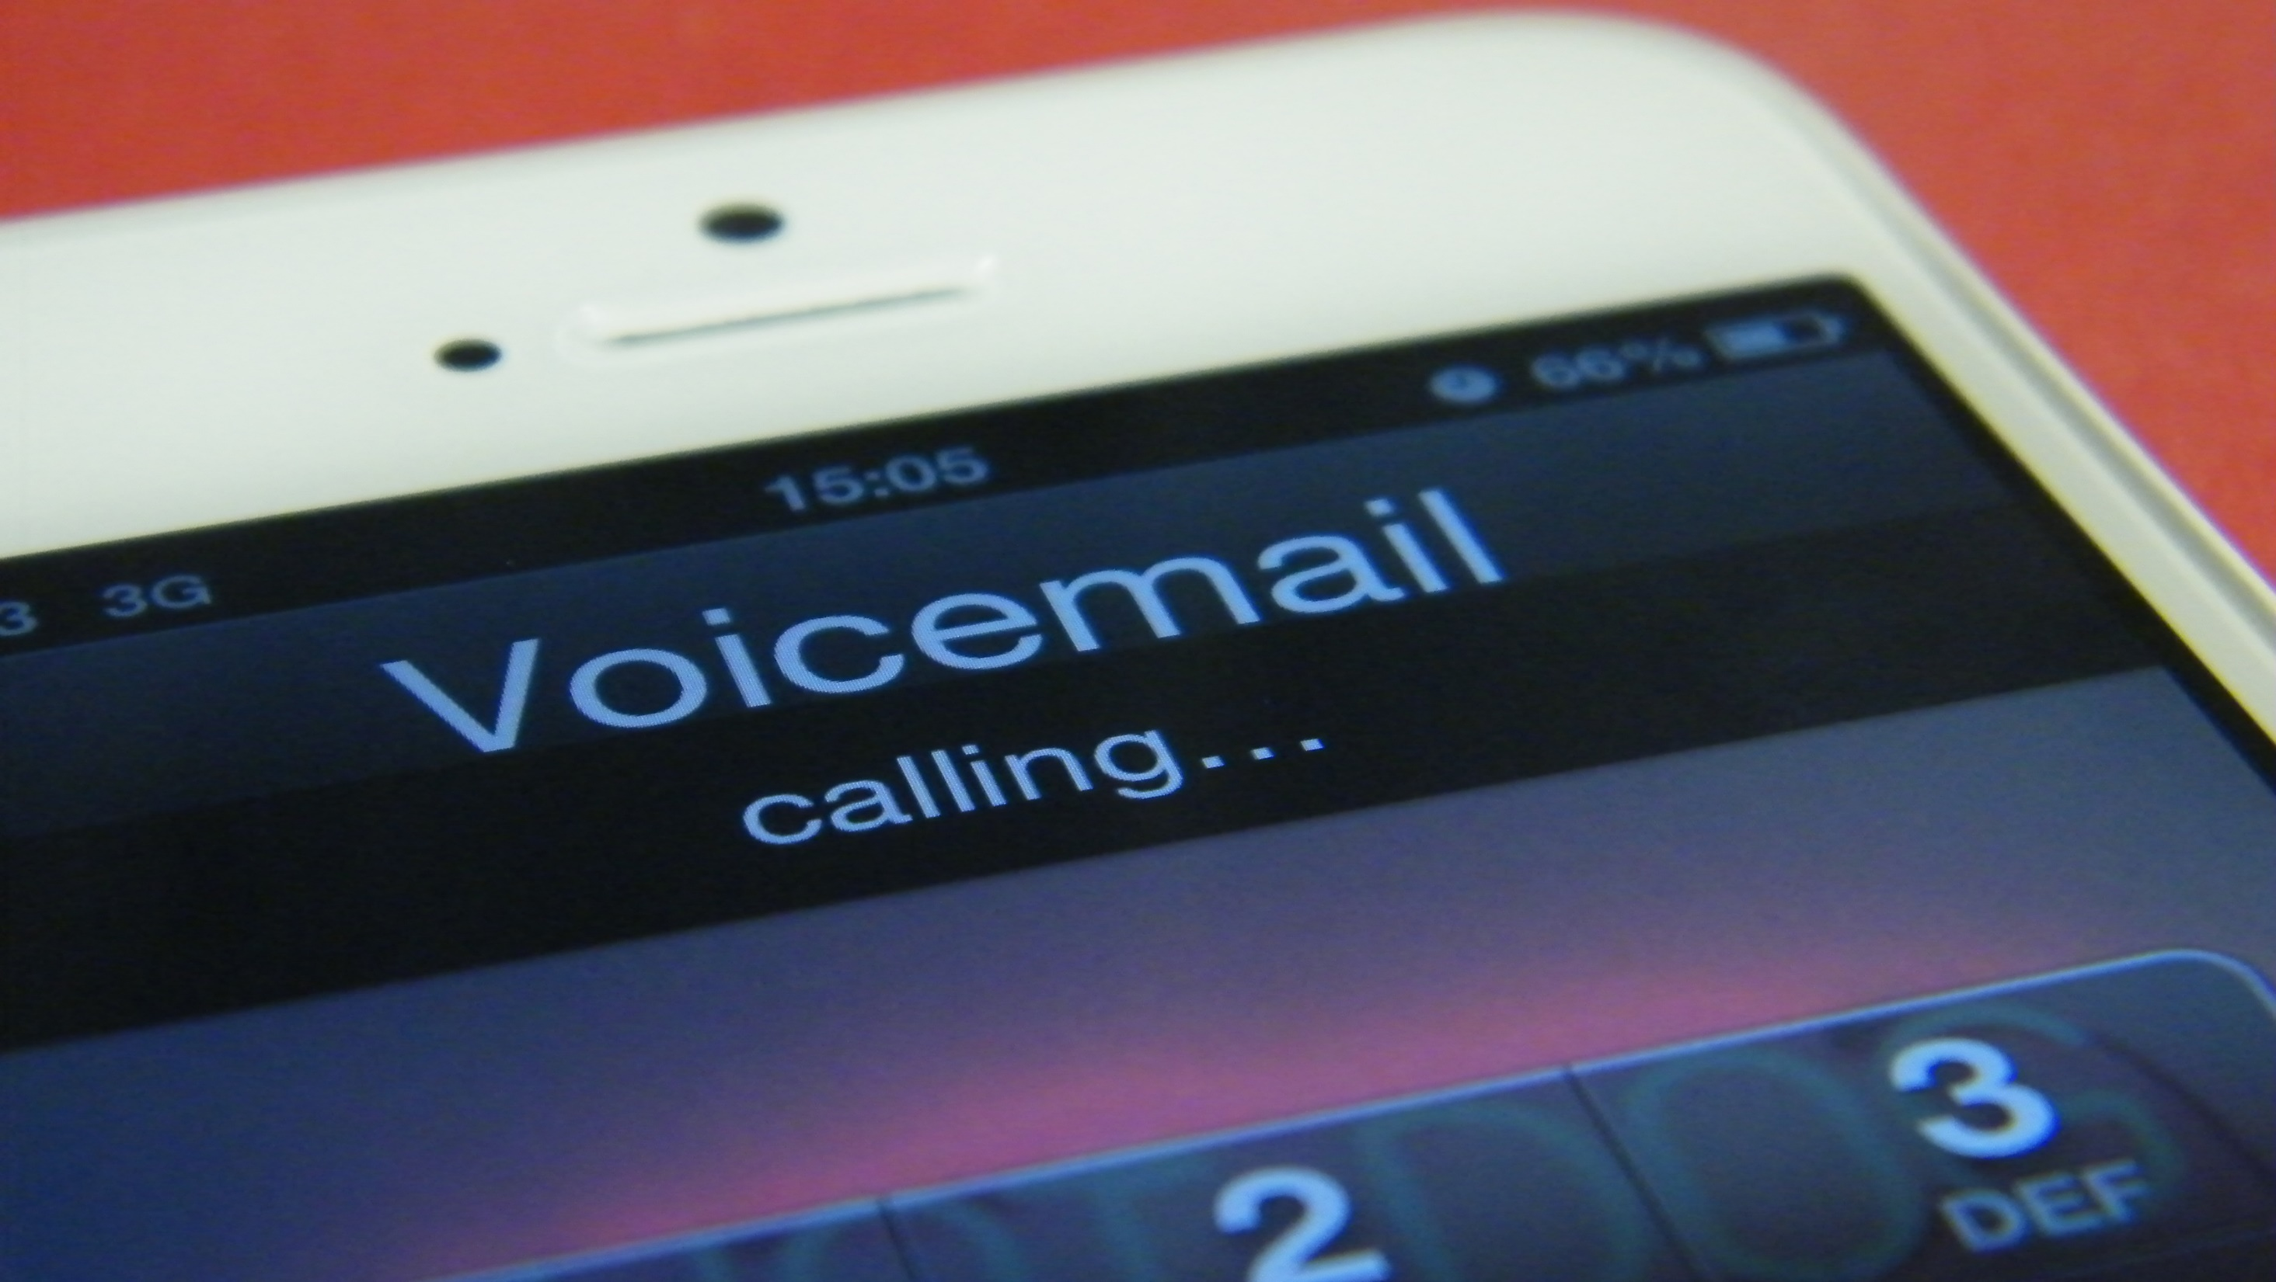
Check your answers.

Slide 18


To leave a message
People can leave a message at any time rather than wait.

Slide 19


Slide 20

Check your answers.

Slide 21
The three callers are talking about:
a. Likes and dislikes
b. Future plans and arrangements
c. Mistakes they made in the past

Slide 23

Check your answers.

Slide 24




- Kevin ( ) 1. Going to the beach
- Suzan ( ) 2. Staying at home
- Ali ( ) 3. Having a guitar lesson

Slide 26

Read your dialogues.

Slide 27
Mother: Hello. This is Mrs. Jones. Who’s calling please?
Peter: …………………………………….....................................………………………….…….
Mother: I’m sorry but he’s not home, would you like to leave a message?
Peter: Could you please tell him ………………………..……… ……………………………………………………………………….……………………….................
Mother: Oh my God! I can’t believe it. I’ll tell him as soon as he gets home.
Peter: …………………………………….....................................………………………….…….
Mother: Bye.
This is Peter. May I speak to John, please?
that our friend
Alan had an accident and he’s now in the hospital.
Thank you. Goodbye.

Slide 28
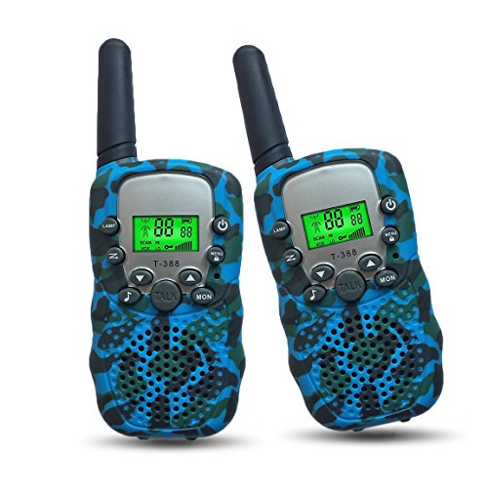
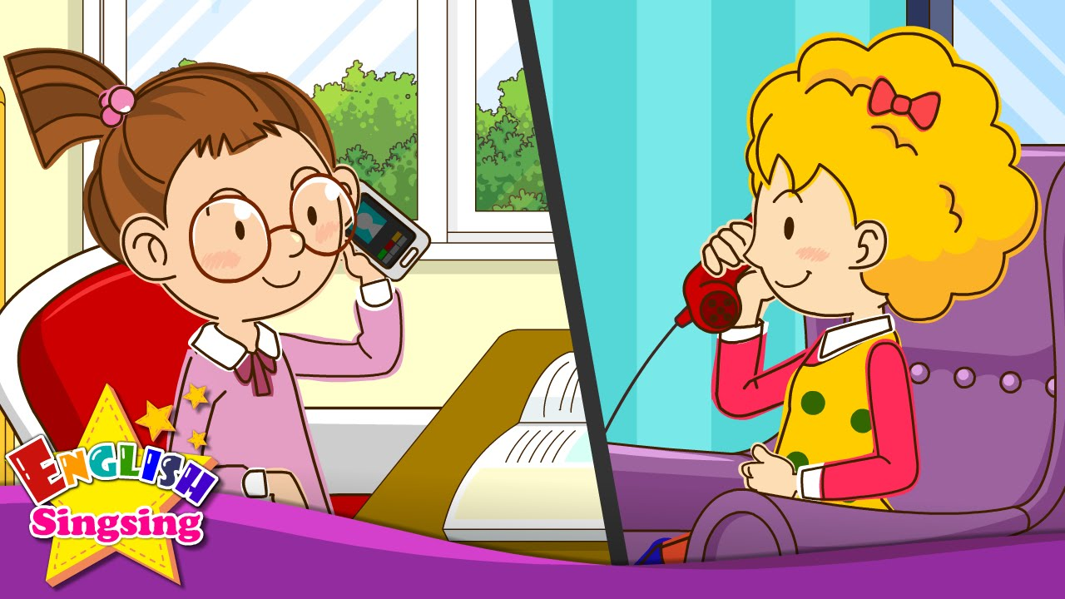

Slide 29

CLOSURE

Slide 30
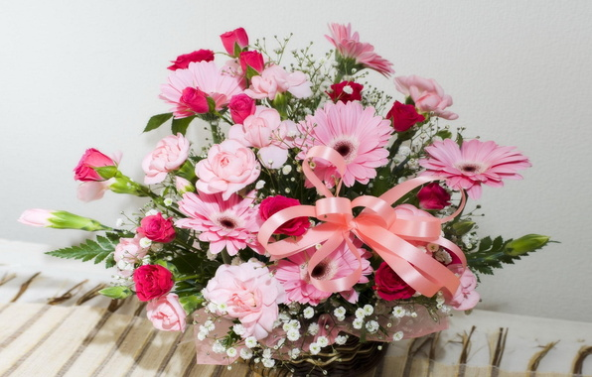
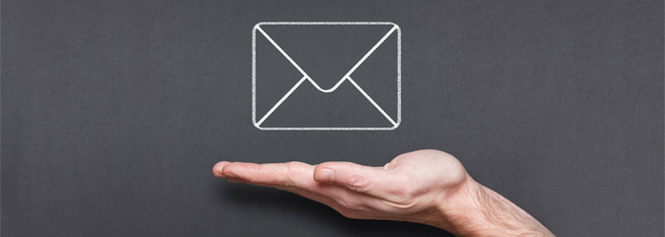
How can you send messages nowadays?

Slide 31


Write an e-mail to a friend about your plans and arrangements for next weekend.

Slide 32


